Slide 1
Digital Portfolio
STUDENT NAME: S . VASIRA BEGAM
REGISTER NO AND NMID: CE73FC08AF320E8ABA048C08A3A67F91
DEPARTMENT: B.Sc COMPUTER SCIENCE
COLLEGE: VIVEKANADA COLLEGE OF of ARTS AND SCIENCE FOR WOMEN / ANNAMALAI UNIVERSITY

Slide 2
PROJECT TITLE
Web Developer Portfolio – Creative & Responsive

Slide 3


AGENDA
Problem Statement
Project Overview
End Users
Tools and Technologies
Portfolio design and Layout
Features and Functionality
Results and Screenshots
Conclusion
Github Link
3/21/2024 Annual Review

Slide 4

PROBLEM STATEMENT
Developers often struggle to showcase their skills and projects effectively with just a resume. Without an online portfolio, it becomes difficult for recruiters and clients to assess their abilities. This project solves the problem by creating a personal portfolio website using HTML, CSS, and JavaScript that is responsive, interactive, and easy to navigate.

Slide 5

PROJECT OVERVIEW
Navbar→ Easy navigation across different sections.
Hero Section→ Engaging introduction with a typing animation.
Projects Section→Highlight of sample projects with hover effects.
Contact Section→ A simple form that allows users to send messages.
Footer→Copyright and branding details.

Slide 6

WHO ARE THE END USERS?
The website includes a navbar, a hero section with typing animation, a projects showcase, a contact form, and a footer. Features like dark/light mode toggle, hover effects, and form validation make the portfolio more attractive and user-friendly.

Slide 7

TOOLS AND TECHNIQUES
Tools:
HTML5 – structure
CSS3 - design & layout
JavaScript – interactivity
VS Code – coding
Browser – testing
Techniques:
Responsive design (flexbox/grid)
DOM manipulation
Form validation
CSS transitions & hover effects

Slide 8
POTFOLIO DESIGN AND LAYOUT
The portfolio has a clean, responsive layout with clear sections:
•Navbar - top navigation menu.
•Hero Section - intro text with typing effect
•Projects Section - grid cards to showcase work.
•Contact Section – simple form for messages.
•Footer - copyright info.
8

Slide 9
FEATURES AND FUNCTIONALITY
•Responsive Design - works on desktop, tablet, and mobile.
•Navbar - quick navigation across sections.
•Hero Section - typing animation for intro text.
•Projects Section - grid layout with hover effects to display work.
•Dark/Light Mode - toggle for better user experience.
•Contact Form - simple form with validation and alert on submit.
•Footer - branding and copyright info.

Slide 10
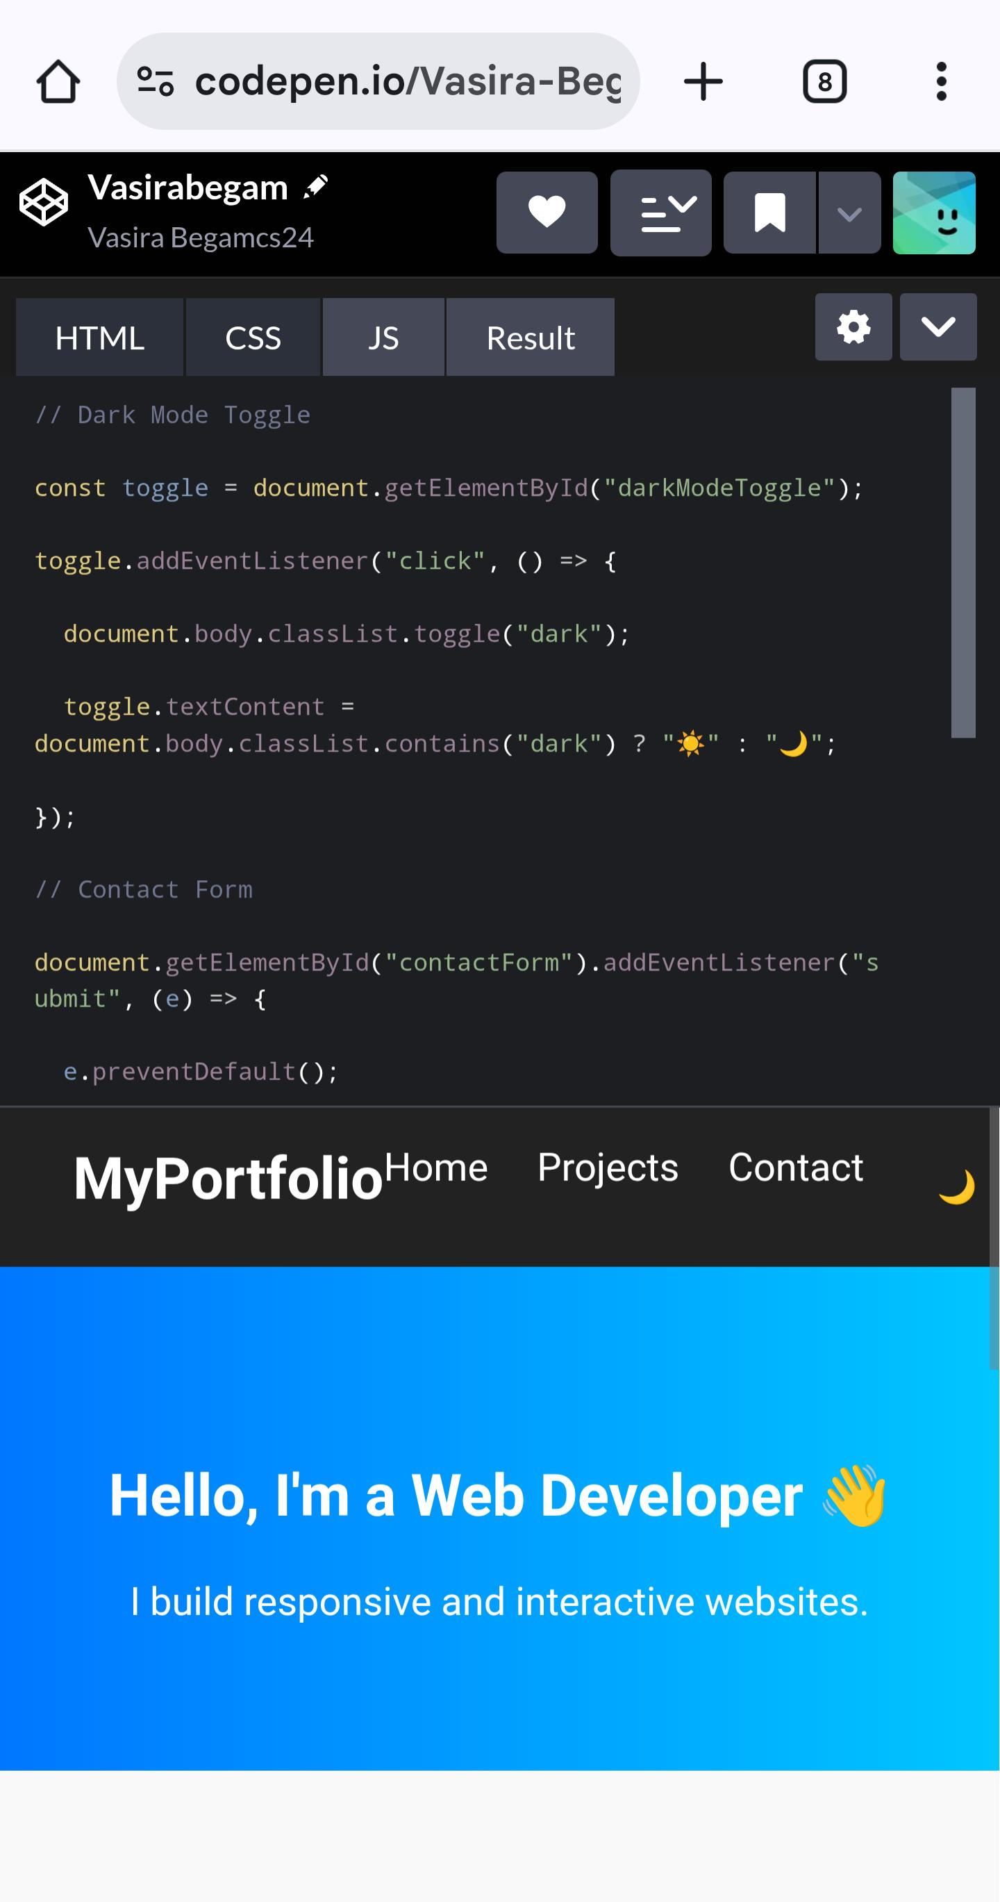
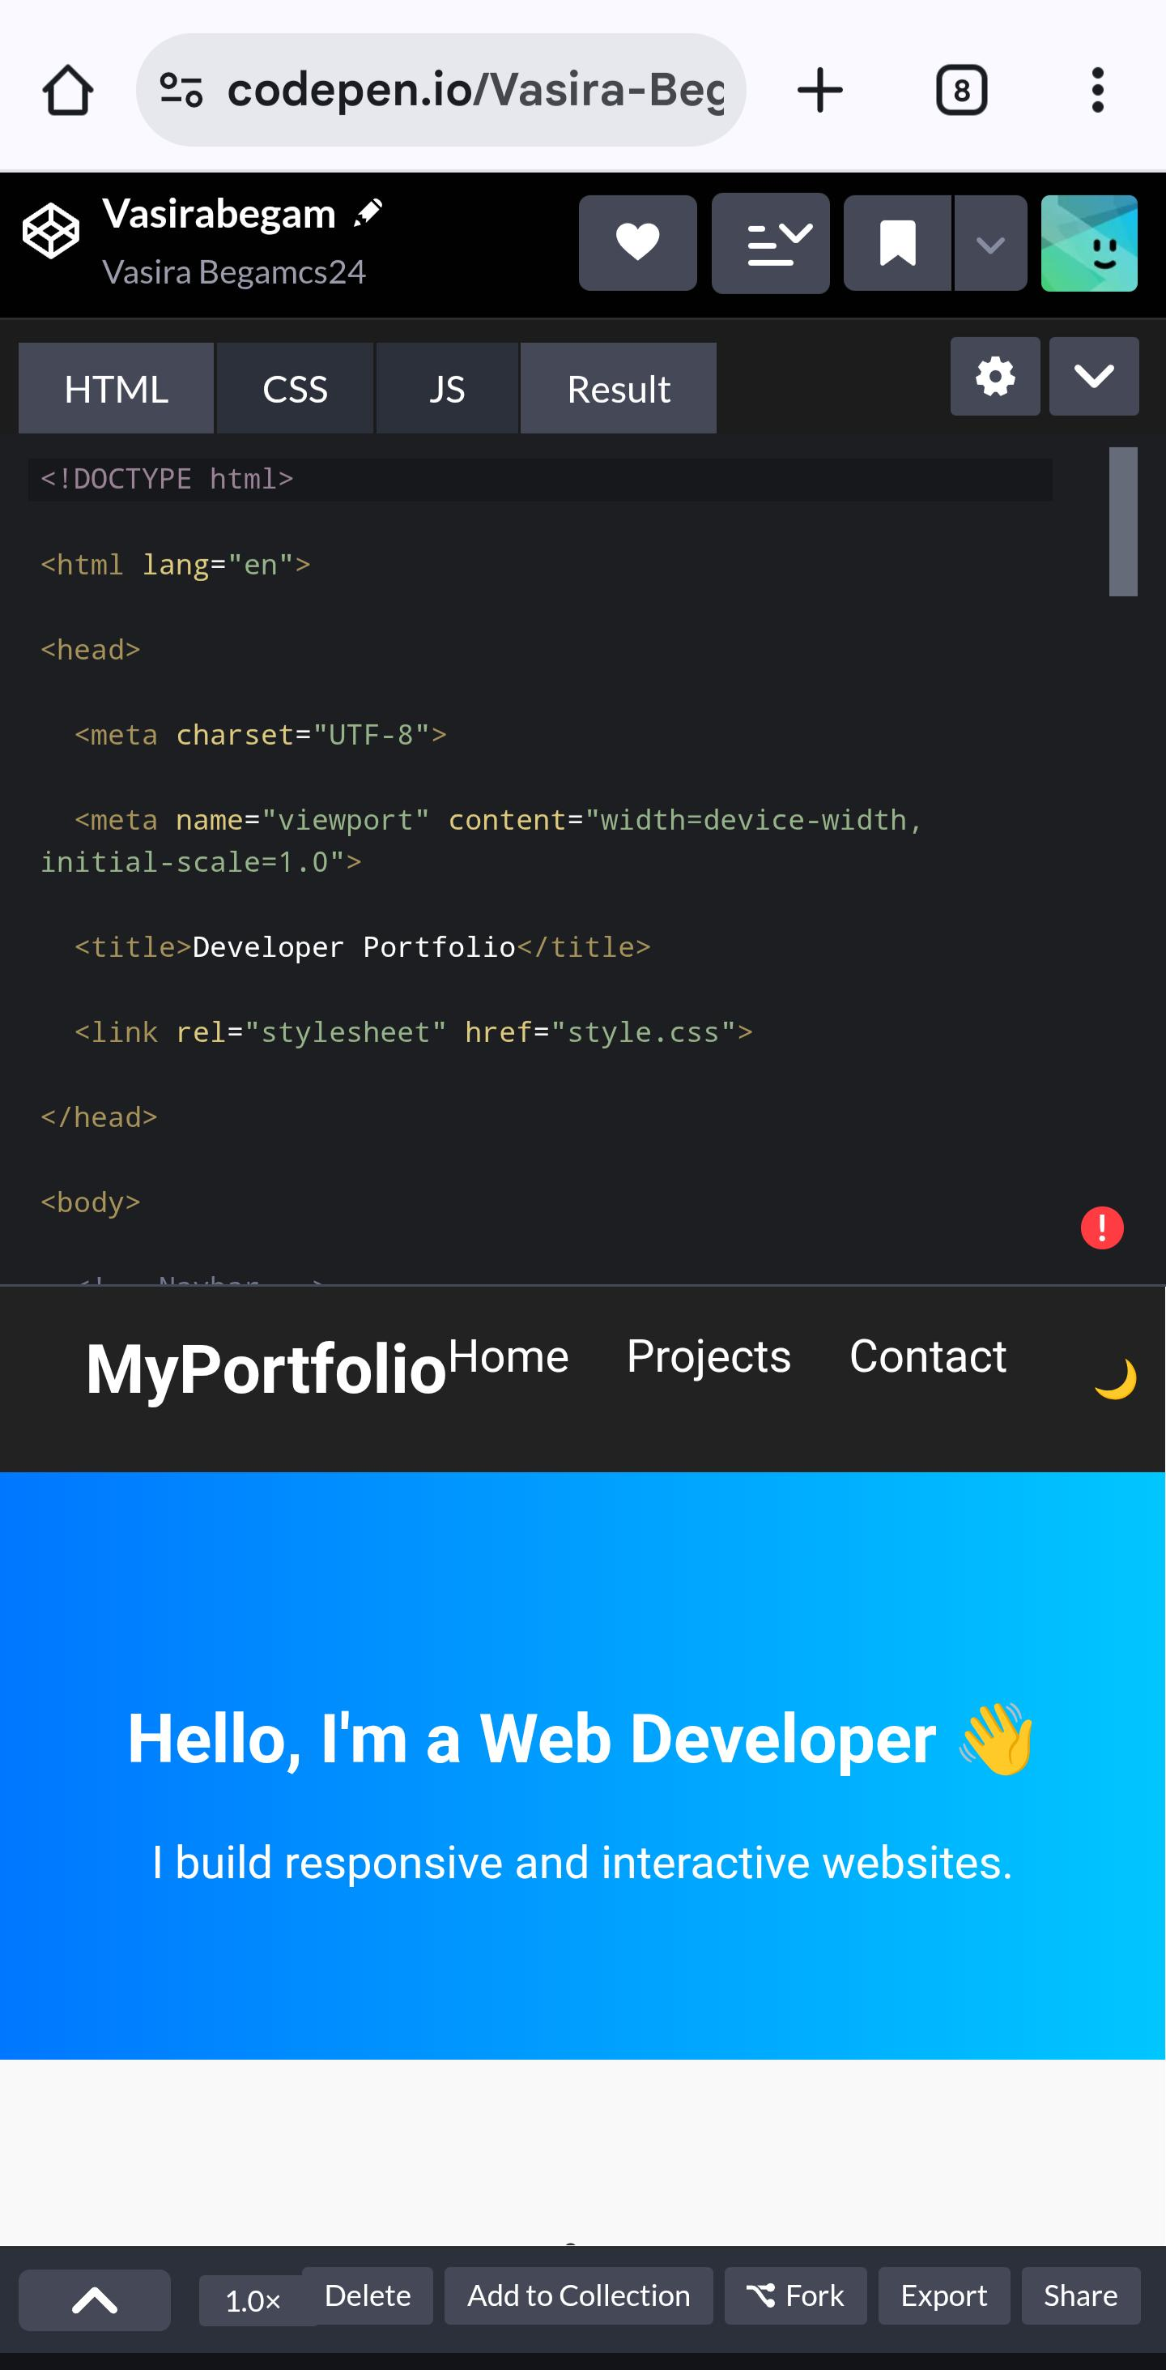

RESULTS AND SCREENSHOTS
3/21/2024 Annual Review
10

Slide 11
CONCLUSION
The portfolio website was built using HTML, CSS, and JavaScript. It is responsive, interactive, and user-friendly, helping showcase skills, projects, and contact details in a professional way.
• GitHub link :
https://github.com/vasirabegam/Vasirabegam-TNSDC-FWD-DP.git
11

